Slide 1

Go, change the world
RV College of
Engineering
Unit -2
Introduction to C

Slide 2

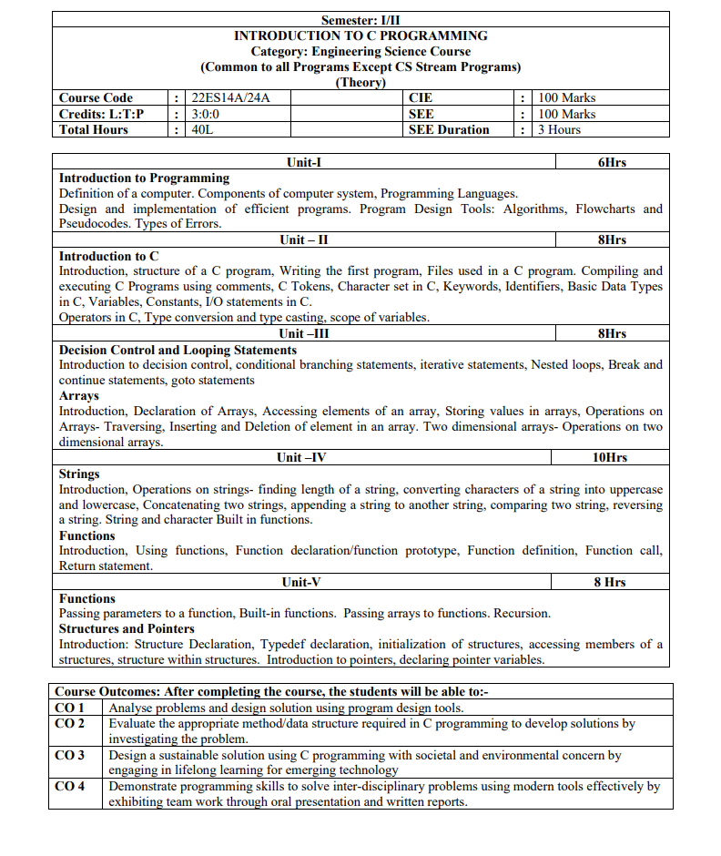
RV College of Engineering
Go, change the world

Slide 3
RV College of Engineering
Go, change the world
Contents
Introduction, structure of a C program, Writing the first program, Files used in a C program. Compiling and executing C Programs using comments, C Tokens, Character set in C, Keywords, Identifiers, Basic Data Types in C, Variables, Constants, I/O statements in C.
Operators in C, Type conversion and type casting, scope of variables.

Slide 4
RV College of Engineering
Go, change the world
Introduction to C
Created in 1972 to write operating systems (Unix in particular)
By Dennis Ritchie at Bell Labs
Evolved from B
It can be portable to other hardware (with careful design – use Plauger’s The Standard C Library book)
Built for performance and memory management
operating systems
embedded systems
real-time systems
communication systems

Slide 5
RV College of Engineering
Go, change the world
C is a High level, general – purpose structured programming language.
Instructions of C consists of terms that similar to algebraic expressions, consisting of certain English keywords such as if, else, for, do and while
C contains certain additional features that allows it to be used at a lower level, acting as bridge between machine language and the high level languages. (Middle Level Language)
This allows C to be used for system programming as well as for applications programming

Slide 6
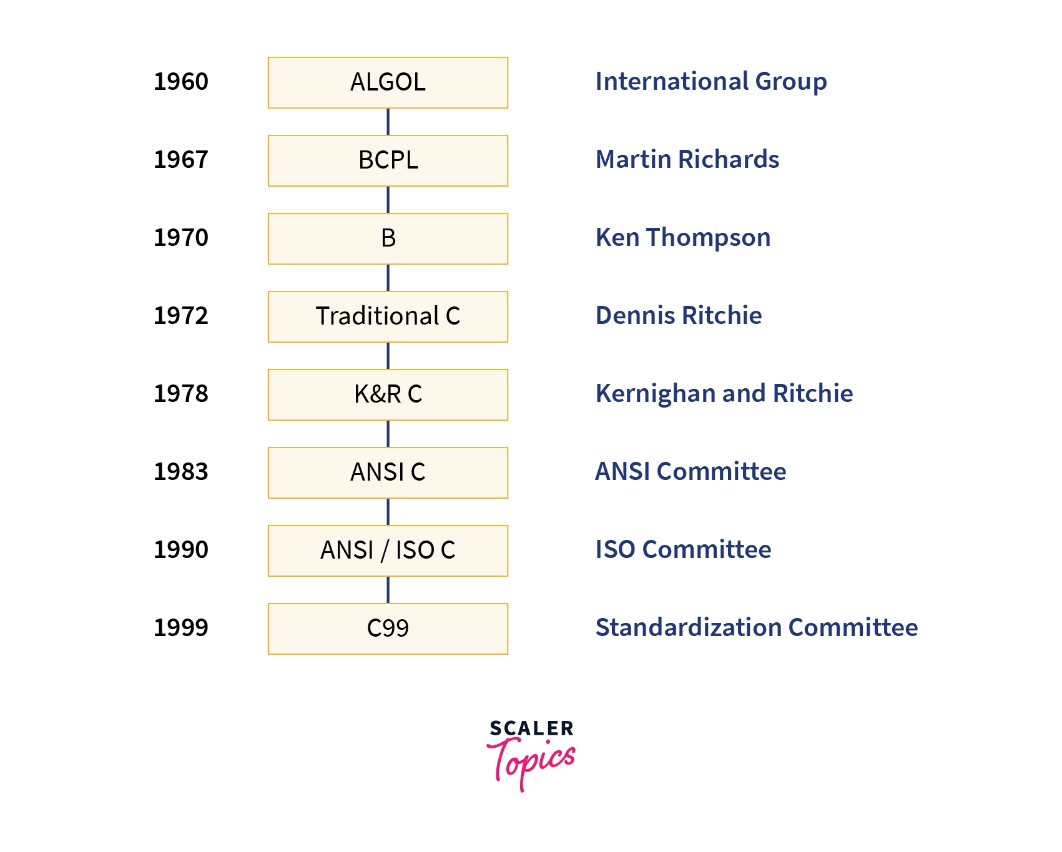
RV College of Engineering
Go, change the world
After C
1979 C++ by Bjarn Stroustrup also at Bell
Object orientation
1991 Java by Sun
Partial compile to java bytecode: virtual machine code
Write once, run anywhere
Memory manager – garbage collection
Many JVMs written in C / C++

Slide 7
RV College of Engineering
Go, change the world
Why C
C is a core language :
In computing, C is a general-purpose, cross-platform, block structured procedural, imperative computer programming language.
There are a number of common and popular computer languages are based on C.
Having learnt C, it will be much easier to learn languages that are largely or in part based upon C.
Such languages include C++, Java, and Perl.

Slide 8
RV College of Engineering
Go, change the world
Features of C
Simple
C is a simple language in the sense that it provides a structured approach (to break the problem into parts), the rich set of library functions, data types, etc.
Machine Independent or Portable
Unlike assembly language, c programs can be executed on different machines with some machine specific changes.
Therefore, C is a machine independent language.
Mid-level programming language
Although, C is intended to do low-level programming.
It is used to develop system applications such as kernel, driver, etc. It also supports the features of a high-level language.
That is why it is known as mid-level language.

Slide 9
RV College of Engineering
Go, change the world
Features of C
Structured Programming Language
C is a structured programming language ie we can break the program into parts using functions.
Easy to understand and modify.
Functions also provide code reusability.
Rich Library - Inbuilt functions that make the development fast.
Memory Management - Dynamic Memory Management

Slide 10
RV College of Engineering
Go, change the world
Features of C
Statically Type
C programming language is a statically typed language.
Meaning the type of variable is checked at the time of compilation but not at run time.
This means each time a programmer type a program they have to mention the type of variables used.
Easy to Extend
Programs written in C language can be extended means when a program is already written in it, then some more features and operations can be added to it.

Slide 11
RV College of Engineering
Go, change the world
main() { Statement 1; Statement 2; ............ Statement N; } Function1() { Statement 1; Statement 2; Statement N; }
Function2() { Statement 1; Statement 2; Statement N; }
Structure of a C program
A C program contains one or more functions, where a function is defined as a group of statements that perform a well-defined task.
The statements in a function are written in a logical sequence to perform a specific task.
The main() function is the most important function and is a part of every C program.
A C program can have any number of functions depending on the tasks that have to be performed, and each function can have any number of statements arranged according to specific meaningful sequence.

Slide 12
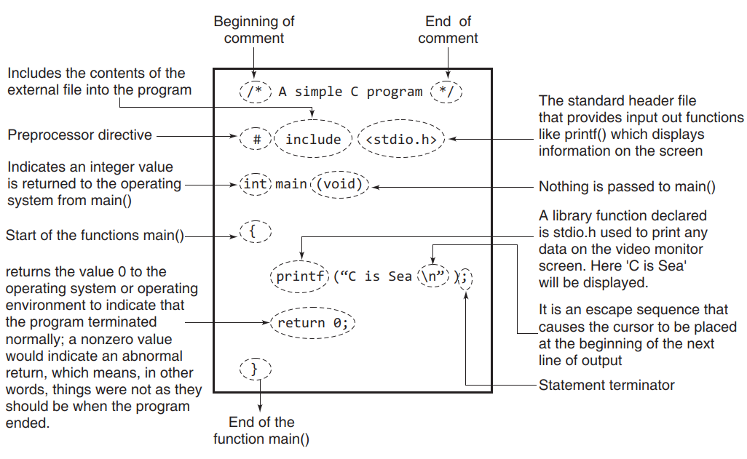
RV College of Engineering
Go, change the world
Structure of a C program

Slide 13
First Program
RV College of
Engineering
Go, change the world
#include <stdio.h>
int main()
{
/* My first program */
printf("Hello World! \n");
return 0;
}
Output :
Hello World!
C is case sensitive.
End of each statement must be marked with a semicolon (;).
Multiple statements can be on the same line.
White space (e.g. space, tab, enter, …) is ignored.

Slide 14
RV College of
Engineering
Go, change the world
First Program
#include <stdio.h>
int main()
{
/* My first program */
printf("Hello World! \n");
return 0;
}
The C program starting point : main().
main() {} indicates where the program actually starts and ends.
In general, braces {} are used throughout C to enclose a block of statements to be treated as a unit.
COMMON ERROR: unbalanced number of open and close curly brackets!
Output :
Hello World!

Slide 15
RV College of
Engineering
Go, change the world
First Program
#include <stdio.h>
int main()
{
/* My first program */
printf("Hello World! \n");
return 0;
}
Output :
Hello World!
#include <stdio.h>
Including a header file stdio.h
Allows the use of printf function
For each function built into the language, an associated header file must be included.
printf() is actually a function (procedure) in C that is used for printing variables and text

Slide 16
RV College of
Engineering
Go, change the world
First Program
Comments
/* My first program */
Comments are inserted between “/*” and “*/”
Or, you can use “//”
Primarily they serve as internal documentation for program structure and function.
#include <stdio.h>
int main()
{
/* My first program */
printf("Hello World! \n");
return 0;
}
Output :
Hello World!

Slide 17
RV College of
Engineering
Go, change the world
First Program
first.c. If you are a Windows user, then open the command prompt by clicking Start->Run and typing “command” and clicking Ok. Using the command prompt, change to the directory in which you saved your file and then type:
C:\>tc first.c
In case you are working on UNIX/Linux operating system, then exit the text editor and type
$cc first.c –ofirst
If everything is right, then no error(s) will be reported and the compiler will create an .exe file for your program. This .exe file can be directly run by typing
"first.exe" for Windows and "./first" for UNIX/Linux operating system
When you run the .exe file, the output of the program will be displayed on screen. That is,
Hello World!

Slide 18
RV College of
Engineering
Go, change the world
First Program
Using Comments
Comments are a way of explaining what a program does. C supports two types of comments.
// is used to comment a single statement.
/* is used to comment multiple statements. A /* is ended with */ and all statements that lie between these characters are commented.
Note that comment statements are not executed by the compiler. Rather, they are ignored by the compiler as they are simply added in programs to make the code understandable by programmers as well as other users.

Slide 19
RV College of
Engineering
Go, change the world
First Program
Standard Header Files
Standard header files include:
string.h : for string handling functions
stdlib.h : for some miscellaneous functions
stdio.h : for standardized input and output functions
math.h : for mathematical functions
alloc.h : for dynamic memory allocation
conio.h : for clearing the screen
All the header files are referenced at the start of the source code file that uses one or more functions from these files.

Slide 20
RV College of
Engineering
Go, change the world
Files used in a C program
Editor - code by programmer
Compiling using gcc:
Preprocess – expand the programmer’s code
Compiler – create machine code for each file
Linker – links with libraries and all compiled objects to make executable
Running the executable:
Loader – puts the program in memory to run it
CPU – runs the program instructions

Slide 21
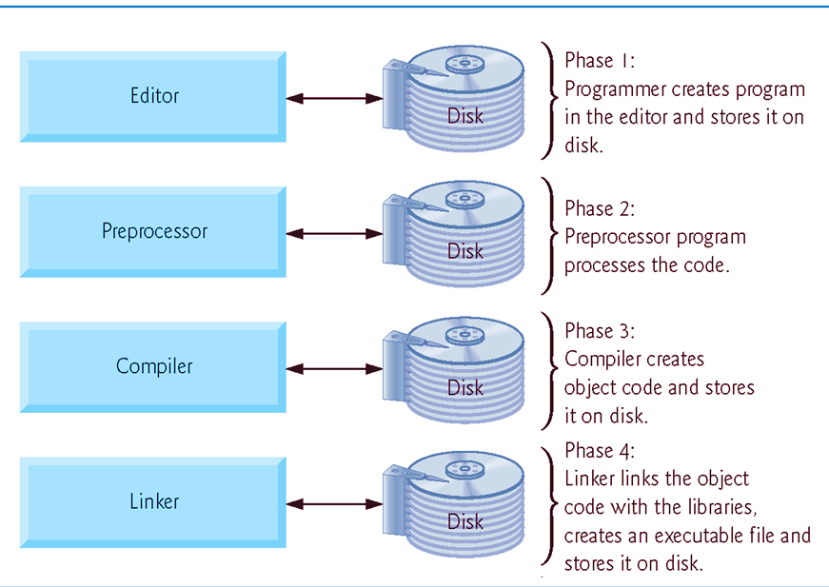
RV College of
Engineering
Go, change the world
Compiling and executing C Programs
Typical C development environment

Slide 22
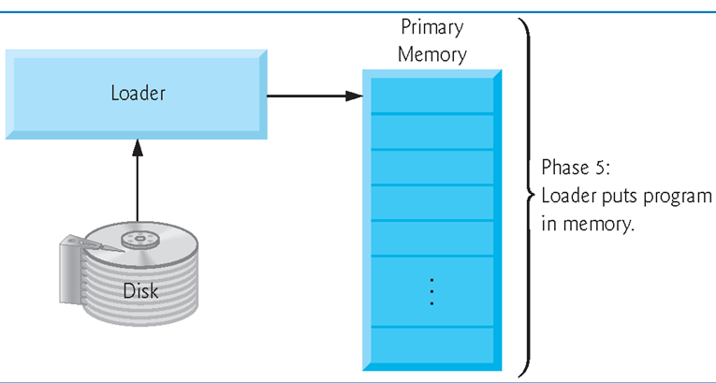
RV College of
Engineering
Go, change the world
Typical C development environment

Slide 23
RV College of
Engineering
Go, change the world
Compiling and Running C Program
The Three main Steps are
1. Writing the C program
2. Compile the program and
3. Executing it.
For these steps, there requires some software components, namely an operating system, a text editor, and the C compiler
The editor is used to create and modify the program code while the compiler transforms the source program to object code.
There are several editors which provide a complete environment for writing managing, developing, and testing your programs.
This is sometimes called an integrated development environment, or IDE.

Slide 24
RV College of
Engineering
Go, change the world
Compiling and Running C Program
Writing or Editing the source program using an text editor
or an IDE and saving it with .c extension.
Programming Environment
Most programming language compilers come with a speciﬁc editor that can provide facilities for managing the programs.
Such an editor offers a complete environment for writing, developing, modifying, deploying, testing, and debugging the programs.
Such software is referred to as an integrated development
environment or IDE.

Slide 25
RV College of
Engineering
Go, change the world
Compiling and Running C Program
Preprocessing is the ﬁrst phase of the C compilation.
It processes include-ﬁles, conditional compilation instructions
and macros.
The C preprocessor is used to modify your program according to the preprocessor directives in your source code.
A preprocessor directive is a statement (such as #deﬁne) that gives the preprocessor speciﬁc instructions on how to modify your source code.
The preprocessor is invoked as the ﬁrst part of your compiler program’s compilation step.
It is usually hidden from the programmer because it is run automatically by the compiler.

Slide 26
RV College of
Engineering
Go, change the world
Compiling and Running C Program
Compilation is the second pass.
The compiler examines each program statement contained in the source program and checks it to ensure that it conforms to the syntax and semantics of the language.
If any mistakes are discovered by the compiler during this phase, they are reported to the user.
The errors then have to be corrected in the source program (with the use of an editor), and the program has to be recompiled

Slide 27
RV College of
Engineering
Go, change the world
Compiling and Running C Program
Linking is the ﬁnal stage of compilation.
After the program has been translated into object code, it is ready to be linked.
The purpose of the linking phase is to get the program into
a ﬁnal form for execution on the computer.
The functions are the part of the standard C library, provided by every C compiler.
The program may use other source programs that were previously processed by the compiler.
These functions are stored as separate object ﬁles which must be
linked to our object ﬁle. Linker handles this linking.

Slide 28
RV College of
Engineering
Go, change the world
Compiling and Running C Program
The process of compiling and linking a program is often called building.
The ﬁnal linked ﬁle, which is in an executable object code format, is stored in another ﬁle on the system, ready to be run or executed.
Under UNIX, this ﬁle is called a.out by default.
Under Windows, the executable ﬁle usually has the same name as the source ﬁle, with the .c extension replaced by an exe extension.
When the program is executed, each of the statements of the program is sequentially executed in turn
If the program requests any data from the user, known as input, the program temporarily suspends its execution so that the input can be entered.
Or, the program might simply wait for an event, such as a mouse being clicked, to occur

Slide 29
RV College of
Engineering
Go, change the world
Compiling and Running C Program
Results that are displayed by the program, known as output, appear in a window, sometimes called the console.
Or, the output might be directly written to a ﬁle on the system.
If all goes well the program performs its intended task.
If the program does not produce the desired results, it is necessary to go back and reanalyze the program.
There are three types of errors that may occur:
Compile errors : These are given by the compiler and prevent the program from not running.
Linking errors : These are given by the linker or at runtime and ends the program.
The linker can also detect and report errors, for example, if part of the program is missing or a non-existent library component is referenced.

Slide 30
RV College of
Engineering
Go, change the world
Compiling and Running C Program
Runtime errors :These are given by the operating system.
Removing errors from a program is called debugging.
Any type of error in your program is known as bug.
During debugging an attempt is made to remove all the
known problems or bugs from the program.
By tracing the program step-by-step, keeping track of each variable, you monitor the program state.
The program state is simply the set of values of all the variables at a given point in program execution.
It is a snapshot of the current state of computation.
.

Slide 31
RV College of
Engineering
Go, change the world
Character Set in C
Just like we use a set of various words, numbers, statements, etc., in any language for communication, the C programming language also consists of a set of various different types of characters.
Characters include digits, alphabets, special symbols etc.
The C language provides support for about 256 characters.
Characters are used for constructing statements .

Slide 32
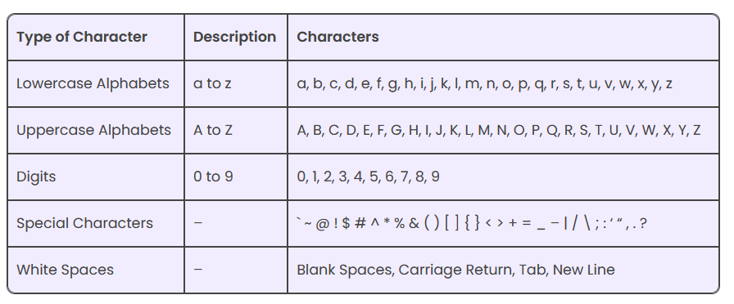
RV College of
Engineering
Go, change the world

Slide 33
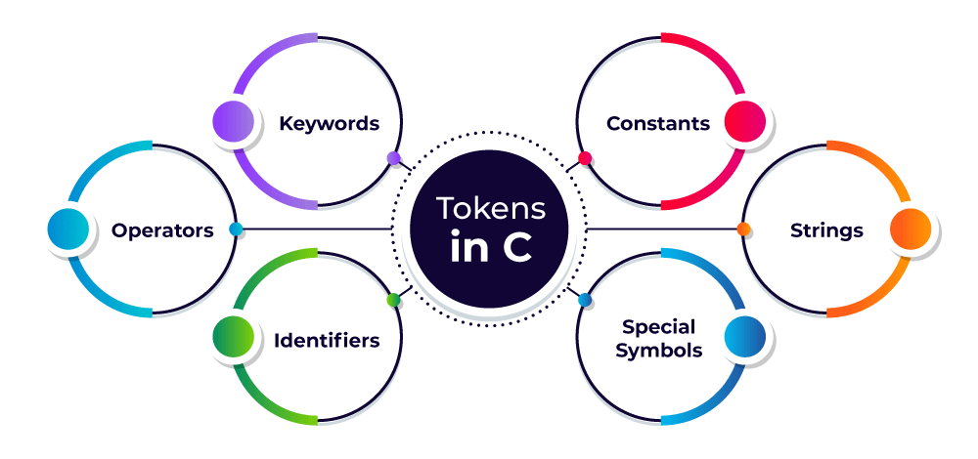
RV College of
Engineering
Go, change the world
C Tokens
The words formed from the character set are building blocks of C and are sometimes known as tokens.
These tokens represent the individual entity of language.
C Tokens
The words formed from the character set are building blocks of C and are sometimes known as tokens. These tokens represent the individual entity of language. The following different types of token are used in C
Character set in C
Keywords
Identifiers
Basic Data Types
Variables
Constants
I/O statements

Slide 34
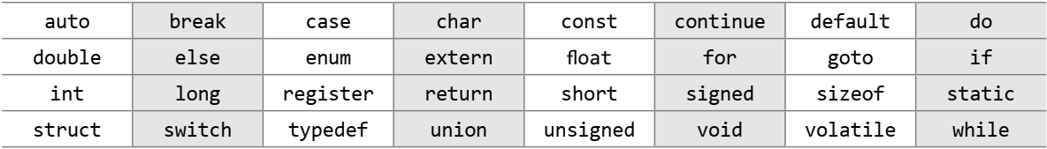
RV College of
Engineering
Go, change the world
Keywords
C has a set of reserved words often known as keywords that cannot be used as an identifier.
All keywords are basically a sequence of characters that have a fixed meaning. By convention, all keywords must be written in lower case letters.
There are 32 keywords in C program
Keywords in C language

Slide 35
RV College of
Engineering
Go, change the world
Identifiers
Identifiers are names given to program elements such as variables, arrays and functions.
They are formed by using a sequence of letters (both uppercase and lowercase), numerals, and underscores
Identifiers cannot include any special characters or punctuation marks (like #, $, ^, ?, ., etc.) except the underscore “_”.
There cannot be two successive underscores.
Keywords cannot be used as identifiers.
The case of alphabetic characters that form the identifier name is significant. For example, ‘FIRST’ is different from ‘first’ and ‘First’.
Identifiers must begin with a letter or an underscore. use of underscore as the first character must be avoided because several complier-defined identifiers in the standard C library have underscore as their first character. So, inadvertently duplicated names may cause definition conflicts.
Identifiers can be of any reasonable length. They should not contain more than 31 characters. (They can actually be longer than 31, but the compiler looks at only the first 31 characters of the name.)

Slide 36
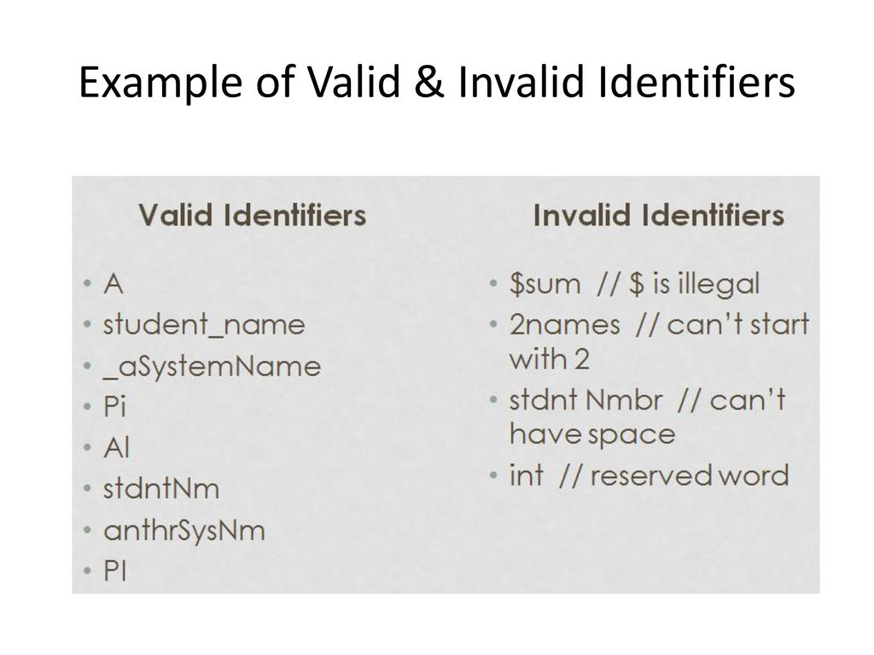
RV College of
Engineering
Go, change the world
Rules to Define Identifiers
They must begin with a letter or underscore(_).
They must consist of only letters, digits, or underscore. No other special character is allowed.
It should not be a keyword.
It must not contain white space.
It should be up to 31 characters long as only the first 31 characters are significant.

Slide 37
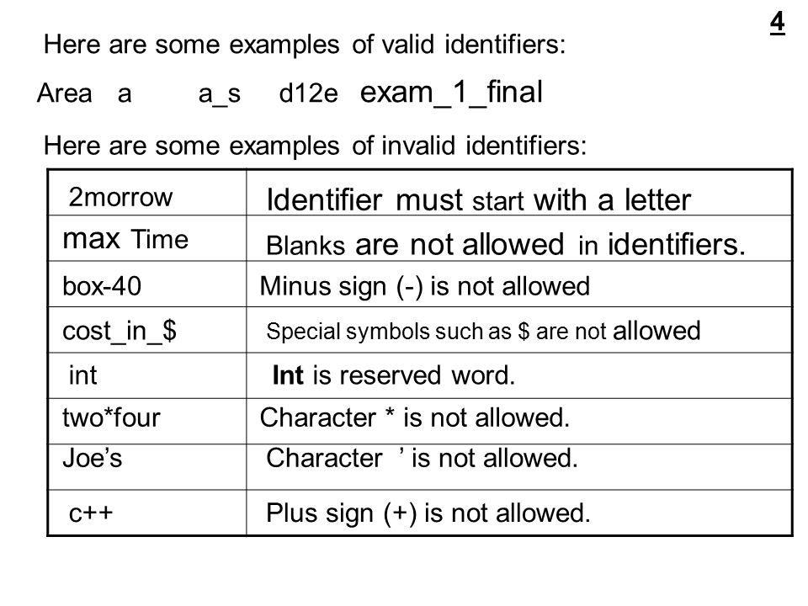
RV College of
Engineering
Go, change the world

Slide 38
RV College of
Engineering
Go, change the world
BASIC DATA TYPES
Data type determines the set of values that a data item can take and the operations that can be performed on the item. C language provides four basic data types. Table 1.2 lists the data types, their size, range, and usage for a C programmer.
Table Basic data types in C
Data Type | Size in Bytes | Range | Use
char | 1 | –128 to 127 | To store characters
int | 2 | –32768 to 32767 | To store integer numbers
float | 4 | 3.4E–38 to 3.4E+38 | To store floating point numbers
double | 8 | 1.7E–308 to 1.7E+308 | To store big floating point numbers

Slide 39
RV College of
Engineering
Go, change the world
BASIC DATA TYPES
In addition, C also supports four modifiers—two sign specifiers (signed and unsigned) and two size specifiers (short and long). Table 1.3 shows the variants of basic data types.
Using modifirs we can extend or limit the range of data type
Table Basic data types and their variants
Data Type | Size in Bytes | Range
char | 1 | –128 to 127
unsigned char | 1 | 0 to 255
signed char | 1 | –128 to 127
int | 2 | –32768 to 32767
unsigned int | 2 | 0 to 65535
signed int | 2 | –32768 to 32767
short int | 2 | –32768 to 32767
unsigned short int | 2 | 0 to 65535
signed short int | 2 | –32768 to 32767
long int | 4 | –2147483648 to 2147483647
unsigned long int | 4 | 0 to 4294967295
signed long int | 4 | –2147483648 to 2147483647
float | 4 | 3.4E–38 to 3.4E+38
double | 8 | 1.7E–308 to 1.7E+308
long double | 10 | 3.4E–4932 to 1.1E+4932

Slide 41
RV College of
Engineering
Go, change the world
Variables
A variable is nothing but a name given to a storage area that our programs can manipulate. Each variable in C has a specific type, which determines the size and layout of the variable's memory; the range of values that can be stored within that memory; and the set of operations that can be applied to the variable.
The name of a variable can be composed of letters, digits, and the underscore character. It must begin with either a letter or an underscore. Upper and lowercase letters are distinct because C is case-sensitive. There are following basic variable types −
Type Description
Char Typically a single octet (one byte). This is an integer type.
int The most natural size of integer for the machine.
float A single-precision floating point value.
Double A double-precision floating point value.
void Represents the absence of type.

Slide 42
RV College of
Engineering
Go, change the world
Variables
Numeric Variables
Numeric variables can be used to store either integer values or floating point values. Modifiers like short, long, signed, and unsigned can also be used with numeric variables.
Character Variables
Character variables are just single characters enclosed within single quotes. These characters could be any character from the ASCII character set—letters (‘a’, ‘A’), numerals (‘2’), or special characters (‘&’).

Slide 43
RV College of
Engineering
Go, change the world
Variables
Declaring Variables
To declare a variable, specify the data type of the variable followed by its name. The data type indicates the kind of values that the variable can store. In C, variable declaration always ends with a semi-colon. For example,
int emp_num;
float salary;
char grade;
double balance_amount;
unsigned short int acc_no;
Initializing Variables
While declaring the variables, we can also initialize them with some value. For example,
int emp_num = 7;
float salary = 9800.99
char grade = ‘A’;
double balance_amount = 100000000;

Slide 44
RV College of
Engineering
Go, change the world
Constants
A constant is a value or an identifier whose value cannot be altered in a program. For example: 1, 2.5,
As mentioned, an identifier also can be defined as a constant. eg. const double PI = 3.14
Here, PI is a constant. Basically what it means is that, PI and 3.14 is same for this program.
Integer constants
A integer constant is a numeric constant (associated with number) without any fractional or exponential part. There are three types of integer constants in C programming:
decimal constant (base 10) ex: 10,525, 22000
octal constant (base 8) Ex: 023,045,07
hexadecimal constant (base 16) Ex: 0x24. oxA5, 0x72b
Declaring Constants
To declare a constant, precede the normal variable declaration with const keyword and assign it a value.
const float pi = 3.14;

Slide 45
RV College of
Engineering
Go, change the world
Constants
Floating-point constants
A floating point constant is a numeric constant that has either a fractional form or an exponent form. For example: 2.0,0.0000234,-0.22E-5
Character constants
A character constant is a constant which uses single quotation around characters. For example: 'a', 'l', 'm', 'F'
String constants
String constants are the constants which are enclosed in a pair of double-quote marks. For example: "good" ,"x", "Earth is round\n"

Slide 46
RV College of
Engineering
Go, change the world
Escape Sequences
Sometimes, it is necessary to use characters which cannot be typed or has special meaning in C programming. For example: newline(enter), tab, question mark etc. In order to use these characters, escape sequence is used.
For example: \n is used for newline. The backslash ( \ ) causes "escape" from the normal way the characters are interpreted by the compiler.escape
Sequences Character
\b Backspace
\f Form feed
\n Newline
\r Return
\t Horizontal tab
\v Vertical tab
\\ Backslash
\' Single quotation mark
\" Double quotation mark
\? Question mark
\0 Null character

Slide 47
RV College of
Engineering
Go, change the world
Operators in C
C language supports different types of operators, which can be used with variables and constants to form expressions. These operators can be categorized into the following major groups:
Arithmetic operators Equality operators Unary operators Bitwise operators Comma operator | Relational operators Logical operators Conditional operator Assignment operators Size of operator

Slide 48
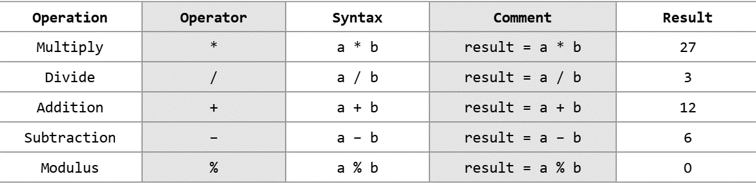
RV College of
Engineering
Go, change the world
Arithmetic Operators
Consider three variables declared as,
int a=9, b=3, result;
Table shows the arithmetic operators, their syntax, and usage in C language.
Table Arithmetic operators
a and b (on which the operator is applied) are called operands.

Slide 49
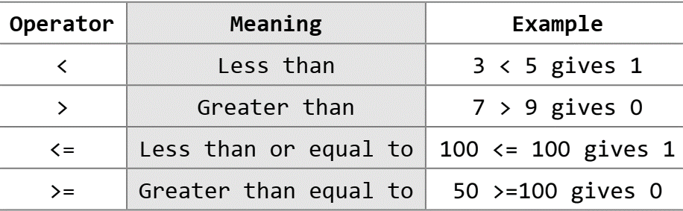
RV College of
Engineering
Go, change the world
Relational Operators
A relational operator, also known as a comparison operator, is an operator that compares two values or expressions. Relational operators return true or false value, depending on whether the conditional relationship between the two operands holds or not.
Table Relational operators

Slide 50
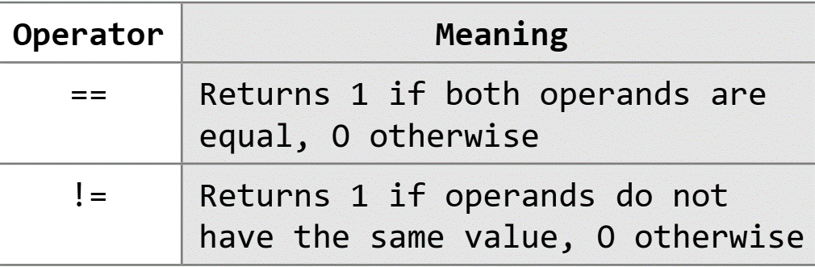
RV College of
Engineering
Go, change the world
Equality Operators
C language also supports two equality operators to compare operands for strict equality or inequality. They are equal to (==) and not equal to (!=) operators. The equality operators have lower precedence than the relational operators.
Table Equality operators

Slide 51
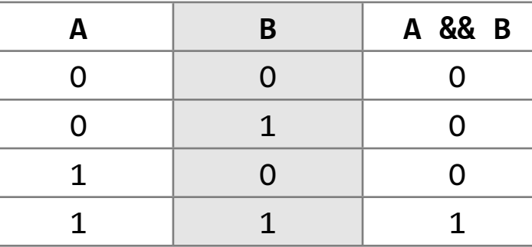
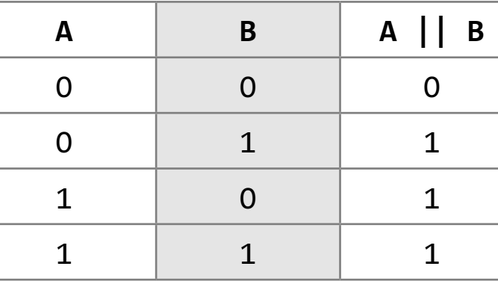
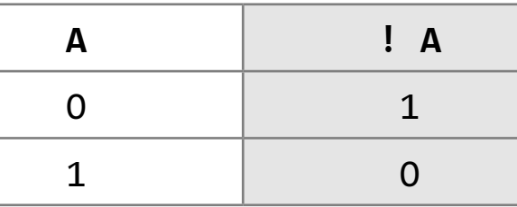
RV College of
Engineering
Go, change the world
Logical Operators
C language supports three logical operators. They are logical AND (&&), logical OR (||), and logical NOT (!). Logical AND and LogicaL OR combines two relational quantities(Ex A>B && B<C). Logical operators in C are used to combine multiple conditions/constraints. Logical Operators returns either 0 or 1,. As in case of arithmetic expressions, logical expressions are evaluated from left to right.
Truth table of logical AND Truth table of logical OR Truth table of logical NOT

Slide 52
Explanation of logical operator program
a= 5, b=5, c=10
(a == b) && (c > 5) evaluates to 1
because both operands (a == b) and (c > b) is 1 (true).
(a == b) && (c < b) evaluates to 0 because operand (c < b) is 0 (false).
(a == b) || (c < b) evaluates to 1 because (a = b) is 1 (true).
(a != b) || (c < b) evaluates to 0 because both operand (a != b) and (c < b)
are 0 (false).
!(a != b) evaluates to 1 because operand (a != b) is 0 (false).
Hence, !(a != b) is 1 (true).
!(a == b) evaluates to 0 because (a == b) is 1 (true).
Hence, !(a == b) is 0 (false).
RV College of
Engineering
Go, change the world

Slide 53
Explanation of logical operator program
a= 5, b=5, c=10
(a == b) && (c > 5) evaluates to 1
because both operands (a == b) and (c > b) is 1 (true).
(a == b) && (c < b) evaluates to 0 because operand (c < b) is 0 (false).
(a == b) || (c < b) evaluates to 1 because (a = b) is 1 (true).
(a != b) || (c < b) evaluates to 0 because both operand (a != b) and (c < b)
are 0 (false).
!(a != b) evaluates to 1 because operand (a != b) is 0 (false).
Hence, !(a != b) is 1 (true).
!(a == b) evaluates to 0 because (a == b) is 1 (true).
Hence, !(a == b) is 0 (false).

Slide 54
RV College of
Engineering
Go, change the world
Unary Operators
Unary operators act on single operands. C language supports three unary operators. They are unary minus, increment, and decrement operators.
Unary Minus (–)
Unary minus operator negates the value of its operand. For example,
int a, b = 10;
a = –(b);
The result of this expression is a = –10
Increment Operator (++) and Decrement Operator (– –)
The increment operator is a unary operator that increases the value of its operand by 1. Similarly, the decrement operator decreases the value of its operand by 1.
The increment/decrement operators have two variants: prefix and postfix. In a prefix expression (++x or – –x), the operator is applied before the operand while in a postfix expression (x++ or x– –), the operator is applied after the operand.

Slide 55
RV College of
Engineering
Go, change the world
Example
int x = 10, y;
y = x++; is equivalent to writing
y = x; /*y = 10*/ (First Assign the value and then Incriment)
x = x + 1; /*x = 11*/
Whereas y = ++x; is equivalent to writing
x = x + 1; /*x = 11*/ (First Increment and than Assign the value)
y = x; /*y = 11*/
int x = 10, y;
y = x- -; is equivalent to writing
y = x; /*y = 10*/ (First Assign the value and then Decriment)
x = x - 1; /*x = 9*/
Whereas y = - -x; is equivalent to writing
x = x - 1; /*x = 9*/ (First Decriment and than Assign the value)
y = x; /*y = 9*/

Slide 56
RV College of
Engineering
Go, change the world
Conditional Operator
The syntax of the conditional operator is
exp1 ? exp2 : exp3
exp1 is evaluated first. If it is true, then exp2 is evaluated and becomes the result of the expression, otherwise exp3 is evaluated and becomes the result of the expression. For example,
large = (a > b) ? a : b
The conditional operator is used to find the larger of two given numbers. First exp1, that is a > b, is evaluated. If a is greater than b, then large = a, else large = b. Hence, large is equal to either a or b, but not both.
Exercises: Find greatest of 2 and 3 numbers using ternary operator.

Slide 57
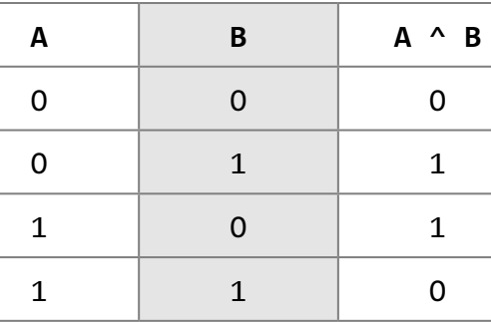
RV College of
Engineering
Go, change the world
Bitwise Operators
As the name suggests, bitwise operators perform operations at the bit level. These operators include: bitwise AND, bitwise OR, bitwise XOR, and shift operators.
Bitwise AND
Like boolean AND (&&), bitwise AND operator (&) performs operation on bits instead of bytes, chars, integers, etc.
For example,
10101010 & 01010101 = 00000000
Bitwise OR
example,
10101010 | 01010101 = 11111111
Bitwise XOR
example,
10101010 ^ 01010101 = 11111111
Table Truth table of bitwise XOR

Slide 58
RV College of
Engineering
Go, change the world
Bitwise NOT (~)
The bitwise NOT or complement is a unary operator that performs logical negation on each bit of the operand.
example,
~10101011 = 01010100
Shift Operators
C supports two bitwise shift operators. They are shift left (<<) and shift right (>>). The syntax for a shift operation can be given as
operand op num
For example, if we have
x = 0001 1101
then x << 1 produces 0011 1010
example, if we have x = 0001 1101, then
x >> 1 gives result = 0000 1110

Slide 59
RV College of
Engineering
Go, change the world
Assignment Operators
In C language, the assignment operator is responsible for assigning values to the variables. While the equal sign (=) is the fundamental assignment operator, C also supports other assignment operators that provide shorthand ways to represent common variable assignments.
For example,
int x;
x = 10;
assigns the value 10 to variable x. The assignment operator has right-to-left associativity, so the expression
a = b = c = 10;
is evaluated as
(a = (b = (c = 10)));

Slide 60
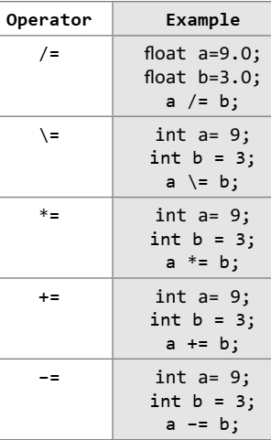

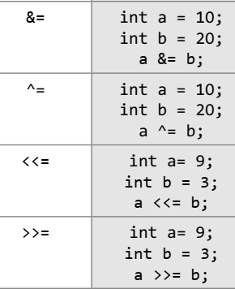
RV College of
Engineering
Go, change the world
Assignment Operators
Table Assignment operators

Slide 61
RV College of
Engineering
Go, change the world
Comma Operator
The comma operator, which is also called the sequential-evaluation operator, takes two operands. It works by evaluating the first expression and discarding its value, and then evaluates the second expression and returns the value as the result of the expression.
For example, the following statement first increments a, then increments b, and then assigns the value of b to x.
int a=2, b=3, x=0;
x = (++a, b+=a);
Now, the value of x = 6.

Slide 62
RV College of
Engineering
Go, change the world
sizeof Operator
sizeof is a unary operator used to calculate the size of data types. This operator can be applied to all data types. When using this operator, the keyword sizeof is followed by a type name, variable, or expression. The operator returns the size of the data type, variable, or expression in bytes. That is, the sizeof operator is used to determine the amount of memory space that the data type/variable/expression will take.
For example, sizeof(char) returns 1, that is the size of a character data type. If we have,
int a = 10;
unsigned int result;
result = sizeof(a);
then result = 2, that is, space required to store the variable a in memory. Since a is an integer, it requires 2 bytes of storage space.

Slide 63
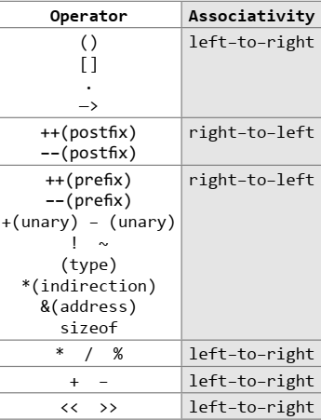
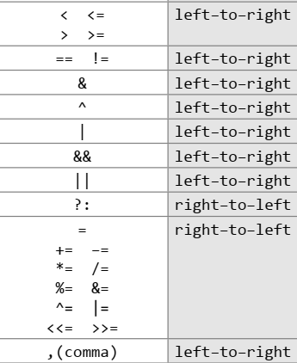
RV College of
Engineering
Go, change the world
Operator precedence Chart
Table lists the operators that C language supports in the order of their precedence (highest to lowest). The associativity indicates the order in which the operators of equal precedence in an expression are evaluated.
Table Operators precedence chart

Slide 64
RV College of
Engineering
Go, change the world
Examples
If we have the following variable declarations:
int a = 0, b = 1, c = –1;
float x = 2.5, y = 0.0;
then,
(a) a && b = 0
(b) a < b && c < b = 1
(c) b + c || ! a
= ( b + c) || (!a)
= 0 ||1
= 1
(d) x * 5 && 5 || ( b / c)
= ((x * 5) && 5) || (b / c)
= (12.5 && 5) || (1/–1)
= 1
(e) a <= 10 && x >= 1 && b
= ((a <= 10) && (x >= 1)) && b
= (1 && 1) && 1
= 1
(f) !x || !c || b + c
= ((!x) || (!c)) || (b + c)
= (0 || 0) || 0
= 0
(g) x * y < a + b || c
= ((x * y) < (a + b)) || c
= (0 < 1) || –1
= 1
(h) (x > y) + !a || c++
= ((x > y) + (!a)) || (c++)
= (1 + 1) || 0
= 1

Slide 65
RV College of
Engineering
Go, change the world
Practice Expressions
int a = 1, b = 0, c = 7;
Expression Numeric Value True/False
a
b
c
a + b
a && b
a || b
!c
!!c
a && !b
a < b && b < c
a > b && b < c
a >= b || b > c

Slide 66
RV College of
Engineering
Go, change the world
I/O statements in C
The most fundamental operation in a C program is to accept input values from a standard input device and output the data produced by the program to a standard output device.
Input and Output statement are used to read and write the data in C programming. These are embedded in stdio.h (standard Input/Output header file).
Input means to provide the program with some data to be used in the program and Output means to display data on screen or write the data to a printer or a file.C programming language provides many built-in functions to read any given input and to display data on screen when there is a need to output the result.
There are mainly two of Input/Output functions are used for this purpose. These are discussed as:
Formatted I/O functions
Unformatted I/O functions

Slide 67
RV College of
Engineering
Go, change the world
Formatted I/O functions
If we want to assign value to variable that is inputted from the user at run-time? this is done by using the scanf function that reads data from the keyboard. Similarly, for outputting results of the program, printf function is used that sends results to a terminal.
A program that uses standard input/output functions must contain the following statement at the beginning of the program:
#include <stdio.h>

Slide 68
RV College of
Engineering
Go, change the world
scanf()
The scanf() function is used to read formatted data from the keyboard. The syntax of the scanf() function can be given as,
scanf ("control string", arg1, arg2, arg3...argn);
The prototype of the control string can be given as,
%[*][width][modifier]type
* is an optional argument that suppresses assignment of the input field.
width is an optional argument that specifies the maximum number of characters to be read.
modifier is an optional argument (h, l, or L) , which modifies the type specifier.
type specifies the type of data that has to be read.
The scanf function ignores any blank spaces, tabs, and newlines entered by the user.

Slide 69
RV College of
Engineering
Go, change the world
the following code that shows how we can input value in a variable of int data type:
int num;
scanf(" %4d ", &num);
The scanf function reads first four digits into the address or the memory location pointed by num.
Table Type specifiers
Type | Qualifying Input
%c | For single characters
%d, %i | For integer values
%e,%E,%f,%g,%G | For floating point numbers
%o | For octal numbers
%s | For a sequence of (string of) characters
%u | For unsigned integer values
%x,%X | For hexadecimal values

Slide 70
RV College of
Engineering
Go, change the world
printf()
The printf function is used to display information required by the user and also prints the values of the variables. Its syntax can be given as:
printf ("control string", arg1,arg2,arg3,...,argn);
The prototype of the control string can
be given as below:
%[flags][width][.precision][modifier]type
Each control string must begin with a % sign.
flags is an optional argument, which specifies output justification like decimal point, numerical sign, trailing zeros or octadecimal or hexadecimal prefixes.
width is an optional argument which specifies the minimum number of positions that the output characters will occupy.
precision is an optional argument which specifies the number of digits to print after the decimal point or the number of characters to print from a string.
modifier field is same as given for scanf() function.
type is used to define the type and the interpretation of the value of the corresponding argument.

Slide 71
RV College of
Engineering
Go, change the world
The most simple printf statement is
printf ("Welcome to the world of C language");
For float x = 8900.768, the following examples show output under different format specifications:
printf("%f", x);
printf("%10f", x);
printf("%9.2f", x);
8 | 9 | 0 | 0 | . | 7 | 6 | 8
 |  | 8 | 9 | 0 | 0 | . | 7 | 6 | 8
 |  | 8 | 9 | 0 | 0 | . | 7 | 7
Table Flags in printf()
Flags | Description
– | Left–justify within the given field width
+ | Displays the data with its numeric sign (either + or –)
# | Used to provide additional specifiers like o, x, X, 0, 0x, or 0X for octal and hexadecimal values respectively for values different than zero
0 | The number is left–padded with zeroes (0) instead of spaces

Slide 72
RV College of
Engineering
Go, change the world
Unformatted I/O functions
There are mainly six unformatted I/O functions discussed as follows:
getchar()
putchar()
gets()
puts()
getch()
getche()
getchar()

Slide 73
RV College of
Engineering
Go, change the world
getchar()
This function is an Input function. It is used for reading a single character from the keyboard. It is a buffered function. Buffered functions get the input from the keyboard and store it in the memory buffer temporally until you press the Enter key.
The general syntax is as:
v = getchar();
where v is the variable of character type. For example:
A simple C-program to read a single character from the keyboard is as:
/*To read a single character from the keyboard using the getchar() function
#include <stdio.h>
main()
{
char n;
n = getchar();
}

Slide 74
RV College of
Engineering
Go, change the world
putchar()
This function is an output function. It is used to display a single character on the screen. The general syntax is as:
putchar(v);
where v is the variable of character type. For example:
A simple program is written as below, which will read a single character using getchar() function and display inputted data using putchar() function:
/*Program illustrate the use of getchar() and putchar() functions*/
#include <stdio.h>
main()
{
char n;
n = getchar();
putchar(n);
}

Slide 75
RV College of
Engineering
Go, change the world
gets()
This function is an input function. It is used to read a string from the keyboard. It is also a buffered function. It will read a string when you type the string from the keyboard and press the Enter key from the keyboard. It will mark null character (‘\0’) in the memory at the end of the string when you press the enter key. The general syntax is as:
gets(v);
where v is the variable of character type. For example:
A simple C program to illustrate the use of gets() function:
/*Program to explain the use of gets() function*/
#include <stdio.h>
main()
{
char n[20];
gets(n);
}

Slide 76
RV College of
Engineering
Go, change the world
puts()
This is an output function. It is used to display a string inputted by gets() function. It is also used to display a text (message) on the screen for program simplicity. This function appends a newline (“\n”) character to the output.
The general syntax is as:
puts(v);
or
puts("text line");
where v is the variable of character type.
Cont.

Slide 77
RV College of
Engineering
Go, change the world
A simple C program to illustrate the use of puts() function:
/*Program to illustrate the concept of puts() with gets() functions*/
#include <stdio.h>
main()
{
char name[20];
puts("Enter the Name");
gets(name);
puts("Name is :");
puts(name);
}
The Output is as follows:
Enter the Name
Geek
Name is:
Geek

Slide 78
RV College of
Engineering
Go, change the world
getch()
This is also an input function. This is used to read a single character from the keyboard like getchar() function. But getchar() function is a buffered is function, getchar() function is a non-buffered function. The character data read by this function is directly assigned to a variable rather it goes to the memory buffer, the character data is directly assigned to a variable without the need to press the Enter key.
Another use of this function is to maintain the output on the screen till you have not press the Enter Key. The general syntax is as:
v = getch();
where v is the variable of character type.
Cont.

Slide 79
RV College of
Engineering
Go, change the world
A simple C program to illustrate the use of getch() function:
/*Program to explain the use of getch() function*/
#include <stdio.h>
main()
{
char n;
puts("Enter the Char");
n = getch();
puts("Char is :");
putchar(n);
getch();
}
The output is as follows:
Enter the Char
Char is L

Slide 80
RV College of
Engineering
Go, change the world
getche()
All are same as getch(0 function execpt it is an echoed function. It means when you type the character data from the keyboard it will visible on the screen. The general syntax is as:
v = getche();
where v is the variable of character type.
Cont.

Slide 81
RV College of
Engineering
Go, change the world
A simple C program to illustrate the use of getch() function:
/*Program to explain the use of getch() function*/
#include <stdio.h>
main()
{
char n;
puts("Enter the Char");
n = getche();
puts("Char is :");
putchar(n);
getche();
}
The output is as follows:
Enter the Char L
Char is L

Slide 82
RV College of
Engineering
Go, change the world
TYPE CONVERSION AND TYPECASTING
Type conversion or typecasting of variables refers to changing a variable of one data type into another. While type conversion is done implicitly, casting has to be done explicitly by the programmer.
Type Conversion
Type conversion is done when the expression has variables of different data types. So to evaluate the expression, the data type is promoted from lower to higher level where the hierarchy of data types can be given as: double, float, long, int, short, and char. For example, type conversion is automatically done when we assign an integer value to a floating point variable. Consider the
following code:
float x;
int y = 3;
x = y;
Now, x = 3.0, as integer value is automatically converted into its equivalent floating point representation.

Slide 83
RV College of
Engineering
Go, change the world
Typecasting
Typecasting is also known as forced conversion. It is done when the value of one data type has to be converted into the value of another data type. The code to perform typecasting can be given as:
float salary = 10000.00;
int sal;
sal = (int) salary;
When floating point numbers are converted to integers, the digits after the decimal are truncated. Therefore, data is lost when floating point representations are converted to integral representations.
As we can see in the code, typecasting can be done by placing the destination data type in parentheses followed by the variable name that has to be converted. Hence, we conclude that typecasting is done to make a variable of one data type to act like a variable of another type.

Slide 84
RV College of
Engineering
Go, change the world
Write a program to calculate the area of a circle.
#include <stdio.h>
#include <conio.h>
int main()
{
float radius;
double area;
clrscr();
printf("\n Enter the radius of the circle : ");
scanf("%f", &radius);
area = 3.14 * radius * radius;
printf(" \n Area = %.2lf", area);
return 0;
}
Output
Enter the radius of the circle : 7
Area = 153.86

Slide 85
RV College of
Engineering
Go, change the world
Write a program to convert an integer into the corresponding floating point number.
#include <stdio.h>
#include <conio.h>
int main()
{
float f_num;
int i_num;
clrscr();
printf("\n Enter any integer: ");
scanf("%d", &i_num);
f_num = (float)i_num;
printf("\n The floating point variant of %d is = %f", i_num, f_num);
return 0;
}
Output
Enter any integer: 56
The floating point variant of 56 is = 56.000000

Slide 86
RV College of
Engineering
Go, change the world
Scope of Variables
A scope is a region of the program and broadly speaking there are three places, where variables can be declared:
Inside a function or a block which is called local variables,
In the definition of function parameters which is called formal parameters.
Outside of all functions which is called global variables.
Here let us explain what local and global variables are.
Local Variables
Variables that are declared inside a function or block are local variables. They can be used only by statements that are inside that function or block of code. Local variables are not known to functions outside their own. Following is the example using local variables:

Slide 87
RV College of
Engineering
Go, change the world
Example : local Variable
#include <stdio.h>
int main ()
{
// Local variable declaration:
int a, b;
int c; // actual initialization
a = 10;
b = 20;
c = a + b;
Printf(“%d”,c);
return 0;
}

Slide 88
RV College of
Engineering
Go, change the world
Global Variables
Global variables are defined outside of all the functions, usually on top of the program. The global variables will hold their type throughout the life-time of your program.
A global variable can be accessed by any function. That is, a global variable is available for use throughout your entire program after its declaration. Following is the example using global and local variables:

Slide 89
RV College of
Engineering
Go, change the world
Example for global variable
#include <stdio.h>
// Global variable declaration:
int g;
int main ()
{
// Local variable declaration:
int a, b;
// actual initialization
a = 10;
b = 20;
g = a + b;
printf(”%d”,g);
return 0;
}

Slide 90
RV College of
Engineering
Go, change the world
#include <stdio.h>
// Global variable declaration:
int g = 20;
int main ()
{
// Local variable declaration:
int g = 10;
Printf(“%d:,g);
return 0;
}
When the above code is compiled and executed, it produces the following result:
10

Slide 91
RV College of
Engineering
Go, change the world
END of UNIT-II

